Slide 1
DESIGN & ANALYSIS OF
SWIMMING POOL LIFT
Group Members:
1. ED15B001 ADARSH S.
2. ME15B044 AKSHAY M.
3. ME15B048 NIKHIL S.
4. ME15B079 ABHIJEET V.
ME6221: THEORY OF MECHANISMS
PROF. SUJATHA SRINIVASAN

Slide 2
OBJECTIVES
Design a swimming pool lift for a wheelchair user in accordance with American with Disability Act 2010
Perform four position motion synthesis to develop a four bar mechanism
Balance the mechanism against toppling
Propose a driver dyad for actuation with high mechanical advantage with optimal link lengths for least force of actuation
Incorporate spring balancing into the design to minimize torque requirements

Slide 3
METHODOLOGY
Counterbalancing
4 Position Synthesis
Force Analysis
Driver Dyad Synthesis
Spring balancing

Slide 4
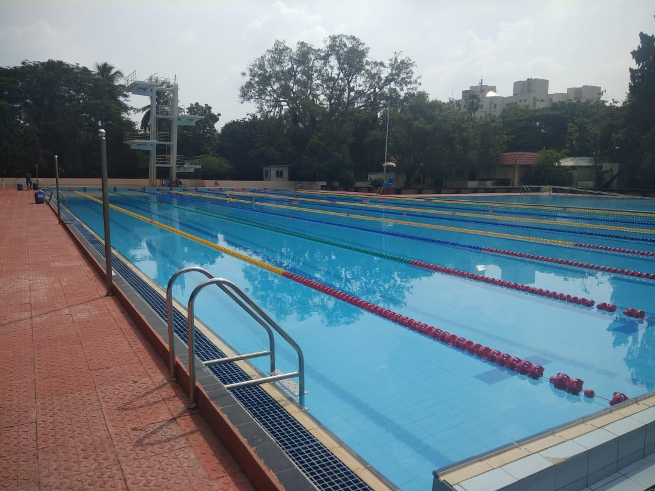
SITE SURVEY
Criteria:
Wheelchair accessibility
Depth of the pool
Space availability for accommodating mechanism

Slide 5
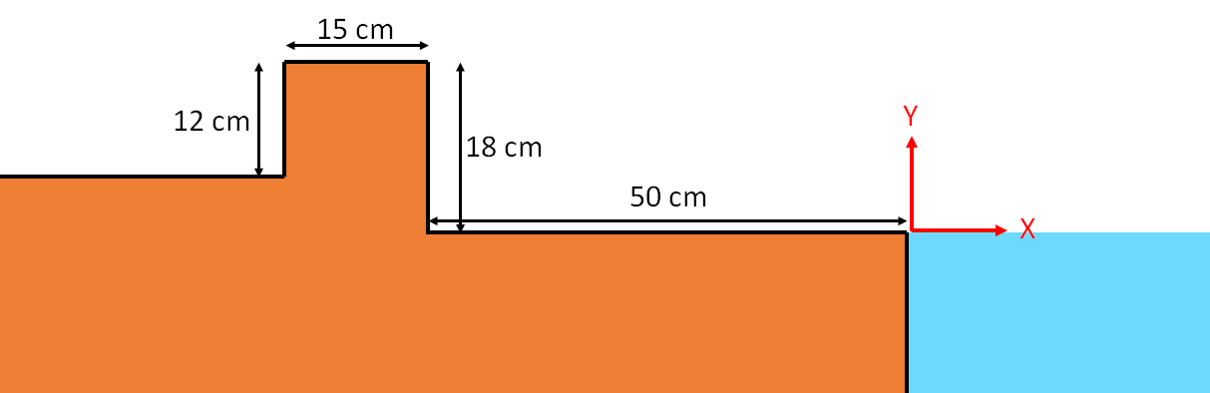
KINEMATIC SYNTHESIS
Initial & final positions chosen based on ADA requirements
(x0,y0) = (-405 mm,485 mm)
(xf,yf) = (700mm,-455mm)

Slide 6
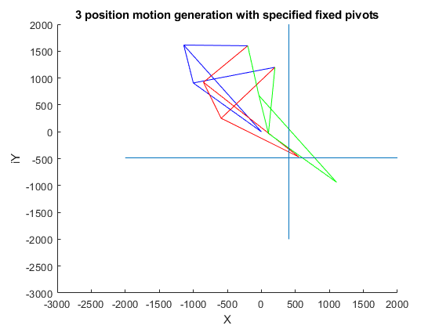
KINEMATIC SYNTHESIS
3 Position synthesis was initially performed to find approximate location of fixed pivots

Slide 7
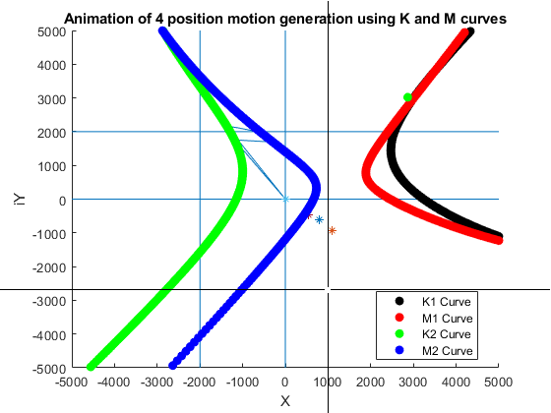
KINEMATIC SYNTHESIS
4 position synthesis performed afterward to generate best locations for fixed pivots

Slide 8
KINEMATIC SYNTHESIS
Link | Length(m) | Direction(deg) at initial pose
Crank length l1 | 0.941 | 179.18
Dyad 1 length l2 | 1.976 | -54.73
Follower length l3 | 1.235 | -166.32
Dyad 2 length l4 | 1.351 | -42.21
Coupler length l5 | 0.719 | -78.77
Base length l6 | 0.565 | -45.00

Slide 9
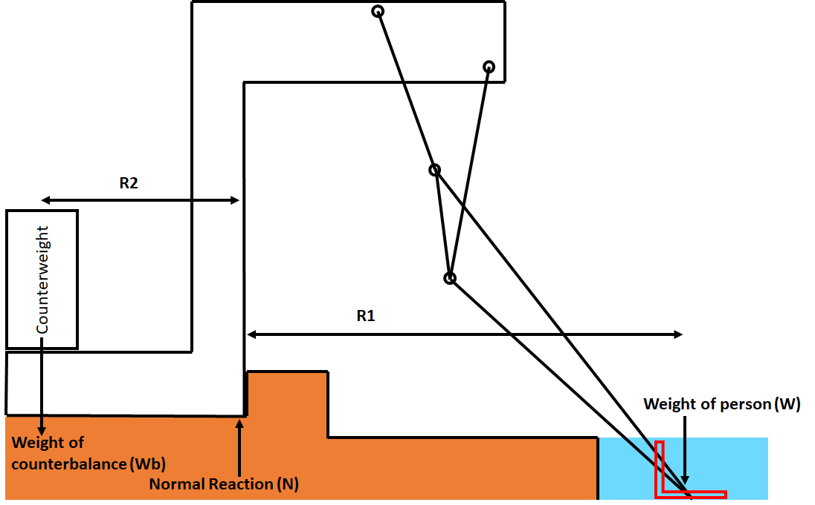
COUNTERBALANCING
2 extreme scenarios:
The person is seated & the mechanism is at its extreme position into the water
There is no one sitting on the mechanism & the mechanism is at its initial position
If we are counterbalancing purely by a mass, then required mass = 150 kgs

Slide 10
COUNTERBALANCING
Alternate proposal: Attach buoys to the frame/mechanism through rigid links
Buoys can be lowered into the water only when necessary & then removed
With a counterbalance of 20 kgs, the buoys need to displace a volume of water equal to around 65 litres at a distance 1.5 m into the pool to provide sufficient counter-moment
As we have control over how the buoys are lowered into the pool, we can ensure the system doesn’t topple in the other direction
Buoys can be actuated by the same linkage

Slide 11
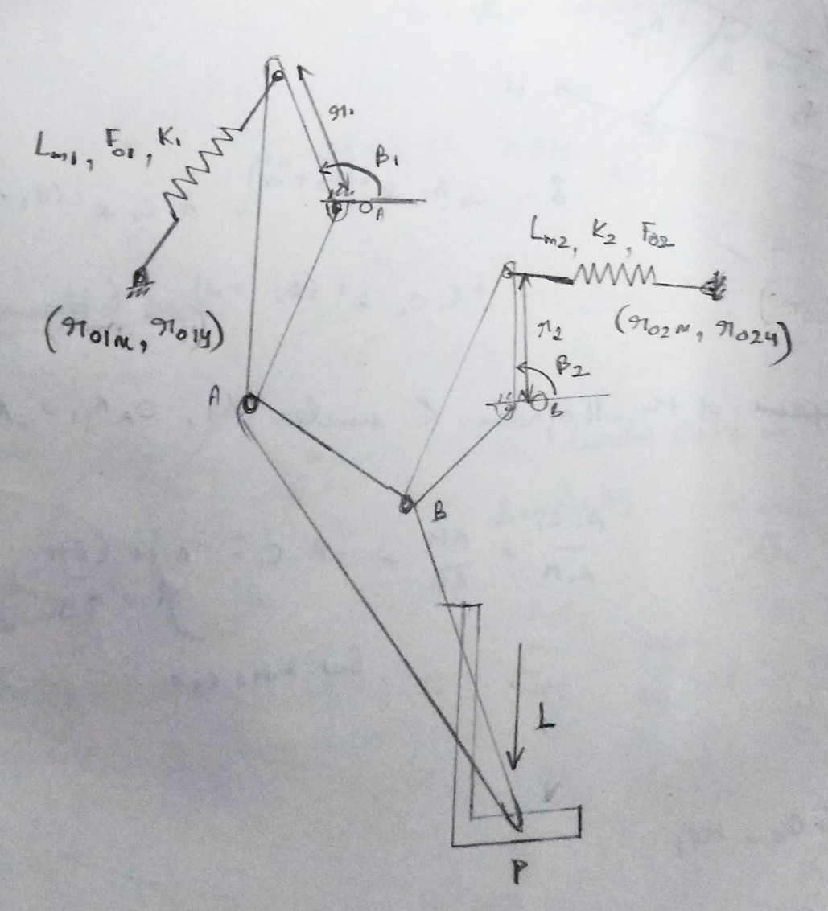
STATIC BALANCING
Potential energy P = f(θ2), θmin < θ2 < θmax
Torque T = -f’(θ2) ~ (P(θ2) - P(θ2 - dθ))/dθ
Mean square torque G = ΣT²/N
Minimize G, subject to:
Variable bounds for spring parameters as per catalogue & practical considerations
Spring compression at any point should be within the specified range

Slide 12
STATIC BALANCING
Case | RMS Value of Input Torque(Nm)
Without balancing | 364.92
With SL06 & SL08 gas spring series | 319.97
With SL10 gas spring series | 14.93
With SL14 gas spring series | 28.60

Slide 13
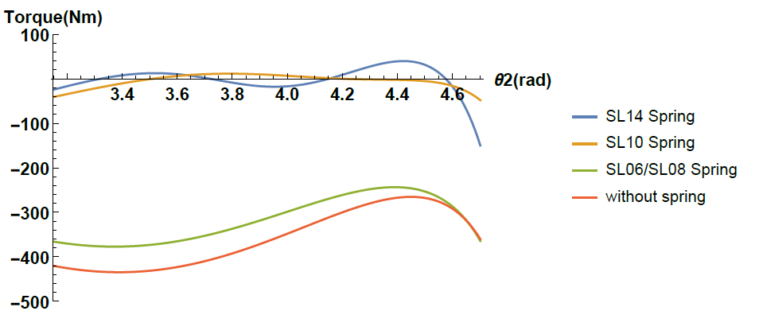
STATIC BALANCING

Slide 14
FORCE ANALYSIS
Quasi-static assumption
Linear mass density : 1 Kg/m
Initial configuration is found & operational range of angle is given as input
Iterate over input angles for force and moment calculations
A*F=B
B= input matrix (accelerations of links)
F= force matrix [ τ Fox Foy F1x F1y F2x F2y F3x F3y]
A= coefficient matrix

Slide 15
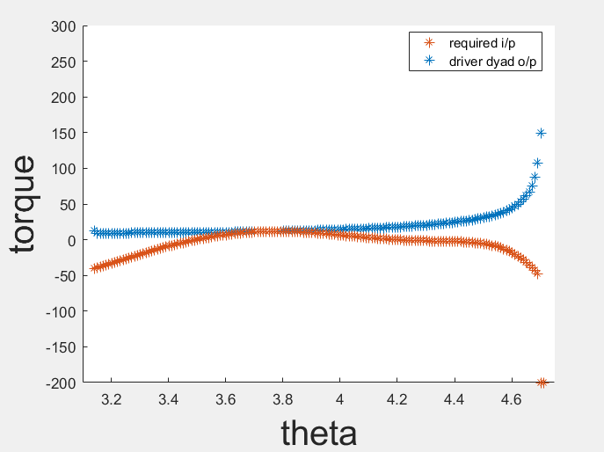
METHOD OF ACTUATION
The driver dyad synthesis is done by optimizing the link lengths for maximum mechanical advantage
The algorithm compares input torque required with the driver dyad output torque
The output of the synthesis is a Grashof-neutral mechanism

Slide 16
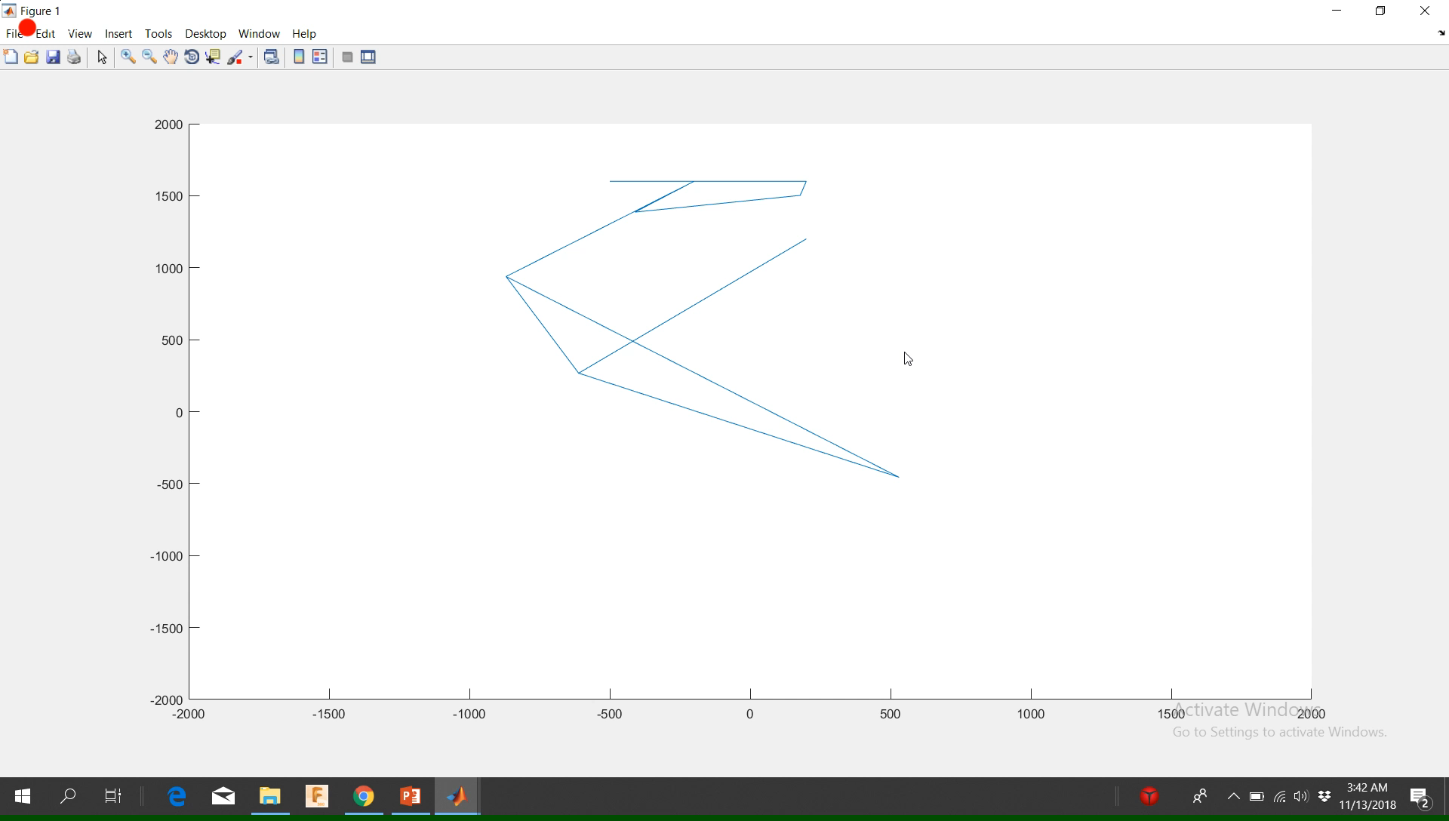
ANIMATION

Slide 17
THANK YOU
This Project was done under the guidance of Prof. Sujatha Srinivasan as part of the course ME6221: Theory of Mechanisms

